Slide 1
M Squared TiSapph Power Loss
SolsTiS gave 5 W of power at 703 nm when bought, has gradually declined to 3.3 W
Three possible issues
Only one that we can definitely fix ourselves
Ruled one out today!

Slide 2
Contamination of Cavity Surfaces
Over time, contamination may build up on optical surfaces in the cavity
First clean external mirrors + mode-matching lenses
Clean crystal facets and cavity mirrors with high purity methanol
To limit further contamination, close off optical table except working space so HEPA filter + positive pressure keeps dust out
Once order is placed for Precilaser 703, will move forward with this

Slide 3
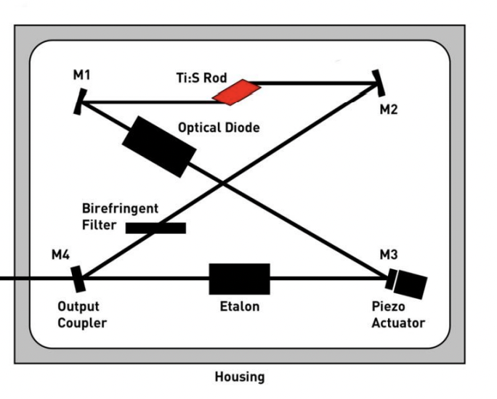
Piezo actuator sag
One of the cavity mirrors is mounted on a ~2 cm piezo stack
Over time, this can sag and misalign cavity
Can check by comparing vertical position of two directions of fluorescence at output coupling mirror
May be able to initially compensate with pump alignment, but eventually mirrors will need to be desoldered/resoldered
Fluorescence 1
Fluorescence 2
Check vertical position of fluorescence

Slide 4
Etalon misalignment
Etalon can drift out of alignment -> higher cavity loss -> lower power
This is hardest to deal with. Cannot fix without desoldering/resoldering components
Can check with etalon reflection photodiode (Provided etalon photodiode voltage < 1.5 V, should be okay)

Slide 5
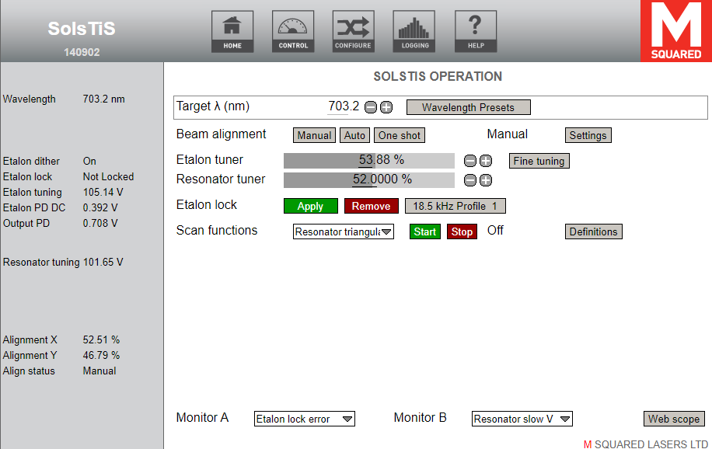
Etalon is okay

